Slide 1

Final project
- Pengujian Web SauceDemo -
- Husein -

Slide 2

introduction
Saya telah melakukan tugas akhir module 9 ini sesuai requirement yang diberikan. Dalam kesempatan ini saya ingin mempresentasikan beberapa bug yang telah saya temui disaat melakukan pengujian.

Slide 3
SauceDemo.com
Features | User Story | Total Test Case | Outstanding Test Case | Passed Test Case | Failed Test Case | DEFECT
CSD-1 | CSD-6 As a buyer, I want to be able to log in to the website | 2 | 0 | 1 | 1 | 2
CSD-2 | CSD-7 As a buyer, I want to be able to open the homepage and see the list of offered products | 2 | 0 | 1 | 1 | 5
CSD-3 | CSD-8 As a buyer, I want to be able to see the details of the product | 2 | 0 | 1 | 1 | 2
CSD-4 | CSD-9 As a buyer I want to be able to add a product to may shopping cart | 3 | 0 | 2 | 1 | 2
CSD-4 | CSD-10 As a buyer I want to be able to manage the products on my shopping cart | 3 | 0 | 2 | 1 | 1
CSD-5 | CSD-11 As a buyer, I want to be able to perform checkout | 7 | 0 | 2 | 5 | 5
CSD-5 | CSD-12 As a buyer, I want to make sure that my purchase details is correct upon checkout | 1 | 0 | 1 | 0
CSD-5 | CSD-13 As a buyer, I want to be able to make payment with credit card | 3 | 3 | 0 | 0
 |  | 23 | 3 | 10 | 10 | 17

Slide 4
fEATURES
LOGIN FEATURES
As a buyer, I want to be able to log in to the website
Homepage showcasing a list of products
As a buyer, I want to be able to open the homepage and see the list of offered products
PRODUCT DETAIL
As a buyer, I want to be able to see the detail of product
Shopping cart
As a buyer I want to be able to add a product to may shopping cart
As a buyer I want to be able to manage the products on my shopping cart
Checkout feature
As a buyer, I want to be able to perform checkout
As a buyer, I want to make sure that my purchase details is correct upon checkout
As a buyer, I want to be able to make payment with credit card (On Progres)

Slide 5
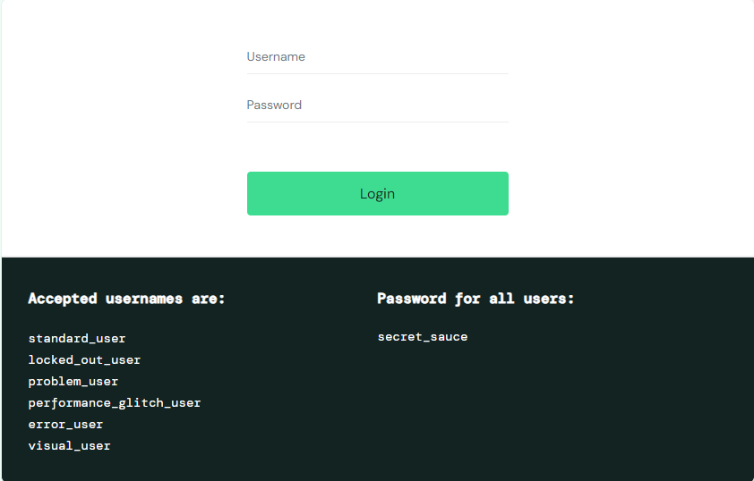
6 username yang tersedia:
standard_user, locked_out_user, problem_user, performance_glitch_user, error_user, dan visual_user

Slide 6
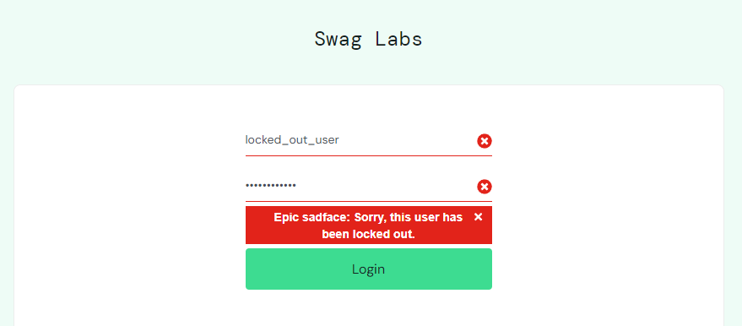
LOGIN fEATURES
Bug Report
Username locked_out_user tidak dapat login
Severity: 3 Priority: 2

Slide 7
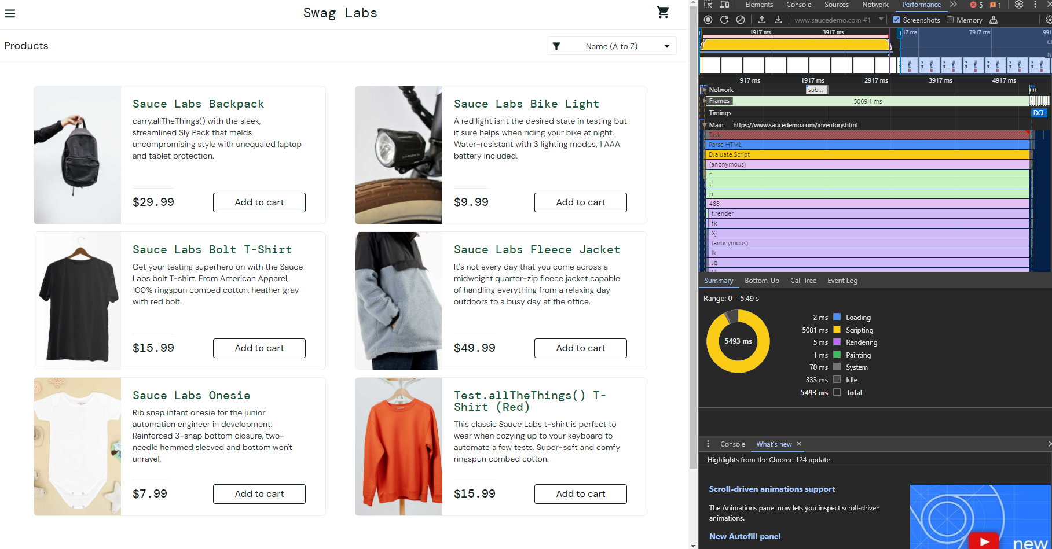
Homepage SHOWCASING a list of product
Bug Report (3 Bug)
Performance_glitch_user: membutuhkan waktu yang lama untuk memuat Homepage namun tetap bisa melihat judul, harga, deskripsi, gambar produk dengan baik
Severity: 3 Priority: 3

Slide 8
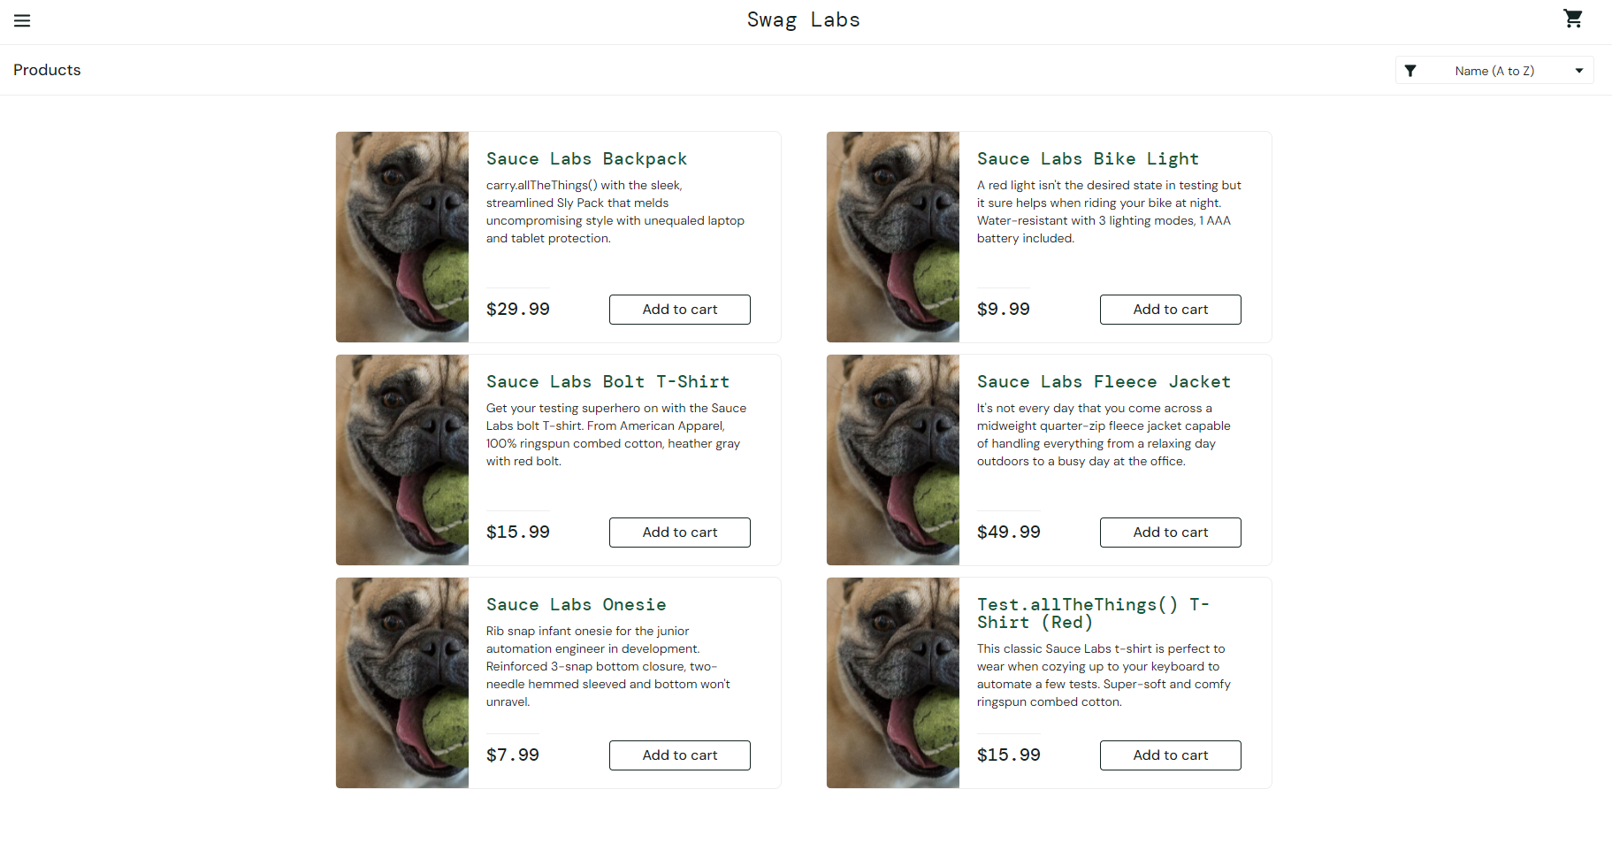
Homepage a list of product
Bug Report
Problem_user: terdapat gambar produk yang tidak sesuai dengan judul dan deskripsinya, dan fungsi sort tidak dapat di gunakan
Severity: 3 Priority: 2

Slide 9
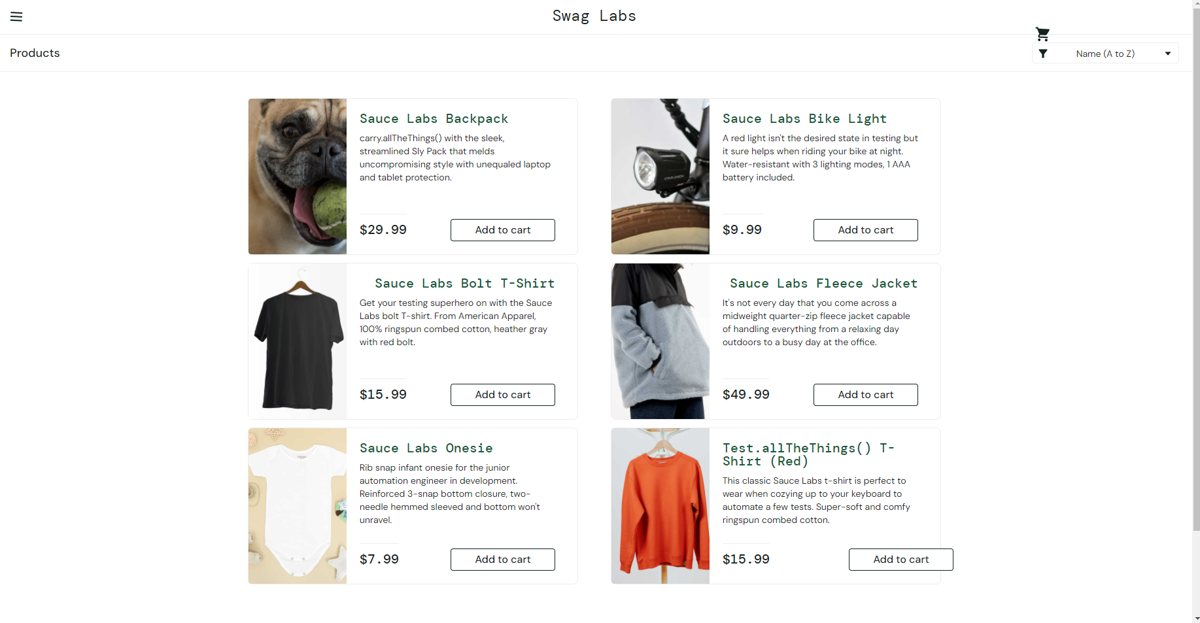
Homepage a list of product
Bug Report
Visual_user: gambar yang tidak sesuai pada produk pertama, dan ui yang tidak tertata dengan rapih
Severity: 3 Priority: 2

Slide 10
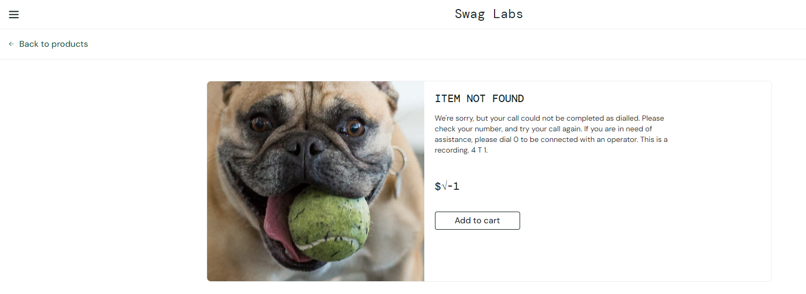
Product details
Bug Report (2 Bug)
Problem_user: terdapat error pada detail produk “Sauce Labs Fleece Jacket”, judul, harga, deskripsi, dan gambar tidak sesuai dengan produk yang di pilih
Severity: 3 Priority: 1

Slide 11
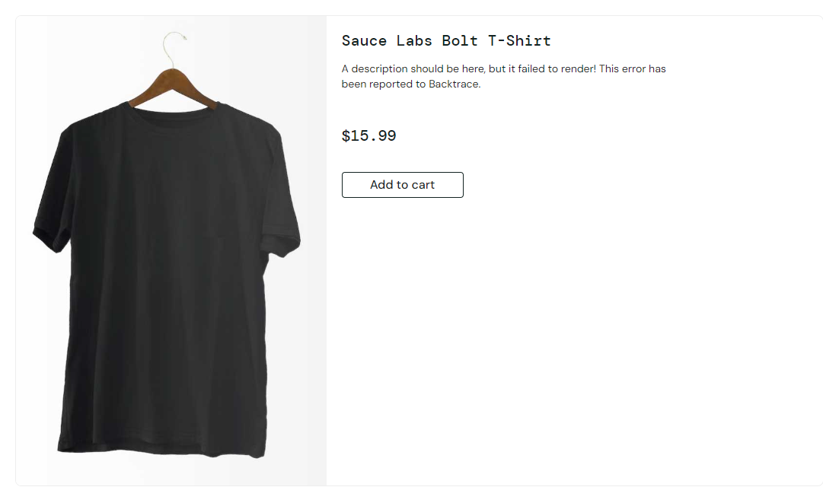
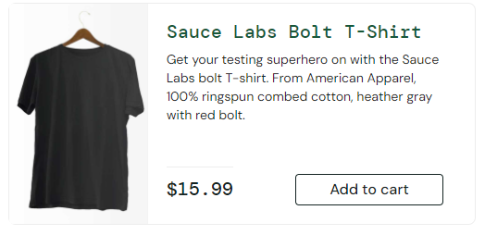
Product details
Bug Report
Error_user: detail produk tidak menampilkan deskripsi yang benar
Homepage
Details Product
Severity: 3 Priority: 2

Slide 12
Shopping cart
As a buyer I want to be able to add a product to may shopping cart
Memastikan pengguna dapat menambahkan produk ke keranjang
5 Username yang di tes:
standard_user, problem_user, performance_glitch_user, error_user, dan visual_user
Terdapat bug pada username berikut: problem_user dan error_user

Slide 13
Shopping cart
As a buyer I want to be able to add a product to may shopping cart
Bug Report (2 Bug)
problem_user dan error_user: terdapat beberapa produk yang tidak bisa di tambahkan ke keranjang
1. Sauce Labs Bolt T-Shirt
2. Sauce Labs Fleece Jacket
3.Test.allTheThings() T-Shirt (Red)
Severity: 2 Priority: 1

Slide 14
Shopping cart
As a buyer I want to be able to manage the products on my shopping cart
Memastikan pengguna bisa manage produk di keranjang
Menghapus produk menggunakan tombol remove
Mengubah quantity pada kolom quantity
Harga akan terkakulasi otomatis sesuai quantity yang di tambahkan
Semua username dapat menggunakan tombol remove untuk menghapus produk
Semua username tedapat bug saat melakukan test quantity karena kolom quantity tidak bisa di edit
Severity: 2 Priority: 1

Slide 15
Checkout feature
As a buyer, I want to make sure that my purchase details is correct upon checkout
Bug Report
problem_user: terjadi error saat menginput data pada Last Name, data yang di input masuk ke kolom Frist Name
Error_user: Tidak bisa menginput data pada kolom last Name
Severity: 2 Priority: 2

Slide 16
Checkout feature
As a buyer, I want to be able to make payment with credit card
Memastikan pengguna untuk bisa melakukan pembayaran menggunakan credit card setelah klik tombol continue setelah mengisi informasi, dan dapat mengisi informasi credit card berupa Card Number, Expiry details, CVV
Fitur ini belum di lakukan tes karna masih tahap pembuatan

Slide 18
Final project
- Pengujian Web Demoblaze -
- Husein -

Slide 19
DEMOBLAZE.com
Test/Suite Name | User Story | Pending |  | Executed |  | Total Test Case | DEFECT
 |  | In Progress | Not Validated | Tests Passed | Tests Failed
Demoblaze | PAB-2 As a user, I wanto to be able to login on the application demoblaze | 0 | 0 | 3 | 1 | 4
Demoblaze | PAB-4 As a user, I want to be able to view Home page | 0 | 0 | 1 | 0 | 1
Demoblaze | PAB-5 As a user, I want to be able to view product baseon category | 0 | 0 | 1 | 0 | 1
Demoblaze | PAB-6 As a user, I want to be able to view next page | 0 | 0 | 2 | 0 | 2
Demoblaze | PAB-7 As a user, I want to be able to view a carousel containing featured products on the home page | 0 | 0 | 1 | 0 | 1
Demoblaze | PAB-9 As a user, I want to be able to register demoablaze application | 0 | 0 | 2 | 2 | 4
Demoblaze | PAB-14 As a user, I wan to be able to view detail product | 0 | 0 | 1 | 0 | 1
Demoblaze | PAB-15 As a user, I wan to be able to add product to cart | 0 | 0 | 1 | 1 | 2
Demoblaze | PAB-16 As a user, I want to be able to delete product from Cart page | 0 | 0 | 1 | 0 | 1
Demoblaze | PAB-17 As a user, I want to be able to purchase product from Cart page | 0 | 0 | 3 | 2 | 5
Demoblaze | PAB-18 As a user, I want to be able to add quantity product | 0 | 0 | 0 | 1 | 1
Demoblaze | PAB-19 As a user, I want to be able to search the product | 0 | 0 | 0 | 1 | 1
 |  | 0 | 0 | 16 | 8 | 24 | 9

Slide 20
fEATURES
LOGIN
As a user, I wanto to be able to login on the application demoblaze
Homepage
As a user, I want to be able to view Home page
As a user, I want to be able to view product baseon category
As a user, I want to be able to view next page
As a user, I want to be able to view a carousel containing featured products on the home page
As a user, I want to be able to search the product
Sign up
As a user, I want to be able to register demoablaze application
product
As a user, I wan to be able to view detail product
As a user, I wan to be able to add product to cart
cart
As a user, I want to be able to delete product from Cart page
As a user, I want to be able to purchase product from Cart page
As a user, I want to be able to add quantity product

Slide 21
login
As a user, I want to be able to login on the application demoblaze
User berhasil login jika memasukan username dan password yang sesuai
Jika user memasukan username yang belum terdaftar tampil popup “User does not exist”
Jika user memasukan password yang salah maka akan tampil “Wrong password.”
Jika salah input password sebanyak 3 kali maka akun akan terblokir
Result:
Sesuai ekspetasi
Sesuai Ekspetasi
Sesuai Ekspetasi
Fail (Akun tetap bisa login Ketika salah password 3 kali) (Severity:3 Priority:2)

Slide 22
homepage
As a user, I want to be able to view Home page
Pengguna dapat melihat homepage dengan baik(PASSED)
As a user, I want to be able to view product baseon category
Pengguna dapat melihat produk sesuai dengan kategorinya dengan cara klik pilihan kategori (PASSED)
As a user, I want to be able to view next page
Pengguna dapat berpindah ke halaman selanjutnya Ketika klik tombol “Next” dan Kembali kehalaman sebelumnya Ketika Klik “Previous” (PASSED)
As a user, I want to be able to view a carousel containing featured products on the home page
Pengguna bisa menampilkan gambar selanjutnya pada carousel Ketika klik tanda panah kanan, dan Kembali Ketika klik tanda panah kiri (PASSED)
As a user, I want to be able to search the product
Tidak ada fitur search atau kolom search pada homepage (FAIL) (Severity:2 Priority:2)

Slide 23
Sign up
As a user, I want to be able to register demoablaze application
User tidak bisa mendaftarkan username yang sudah terdaftar.
Username yang dibuat tidak boleh mengandung spesial karakter.
Password harus mengandung minimal satu huruf besar, satu huruf kecil, satu special karakter dan satu angka.
Minimal password harus 8 karakter
Bug yang ditemukan:
Username dapat di buat menggunakan special karakter (Severity:3 Priority:2)
Password yang tidak sesuai aturan bisa di daftarkan (Severity:3 Priority:2)
Password dengan karakter dibawah 8 bisa di daftarkan (Severity:3 Priority:2)

Slide 24
Product
As a user, I wan to be able to view detail product
Berhasil menampilkan halaman detail produk
Pada halaman detail produk terdapat fitur menambahkan ke wishlist
Bug yang ditemukan:
Hanya ada fitur “Add to cart”, tidak ada fitur menambahkan ke wishlist

Slide 25
Cart
As a user, I want to be able to delete product from Cart page
Pengguna dapat menghapus produk dari cart dengan mengklik tombol “Remove”, dan produk dapat ditambahkan kembali.
As a user, I want to be able to purchase product from Cart page
Kolom Name wajib diisi
Kolom Country wajib diisi
Credit card wajid diisi
Tidak bisa melakukan purchase product jika belum login terlebih dahulu
As a user, I want to be able to add quantity product
User bisa mengurangi atau menambahkan quantitas produk
Bug yang ditemukan:
Pengguna dapat melakukan purchase tanpa melakukan login (Severity:2 Priority:1)
Pengguna dapat melakukan purchase dengan mengisi Nama dan Credit card saja (Severity:3 Priority:1)
Pengguna tidak bisa mengedit quantitas produk karna tidak di temukan fitur quantitas (Severity:2 Priority:2)

Slide 27
Final project SQL
-programiz.com-
- Husein -

Slide 28
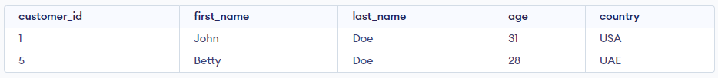
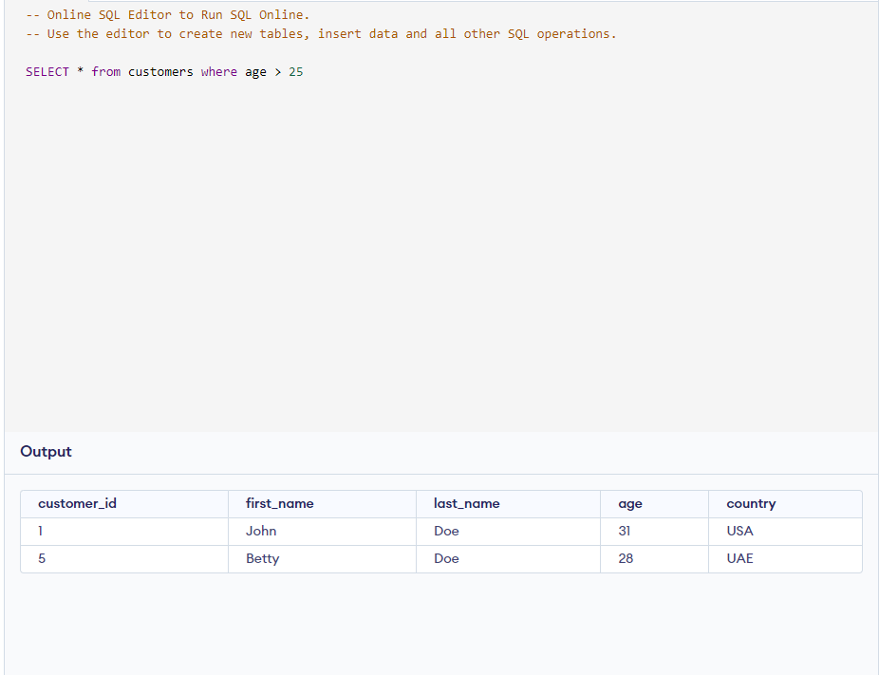
Menampilkan semua pelanggan yang berusia diatas 25 tahun
Result

Slide 29
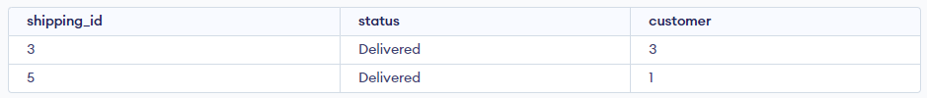
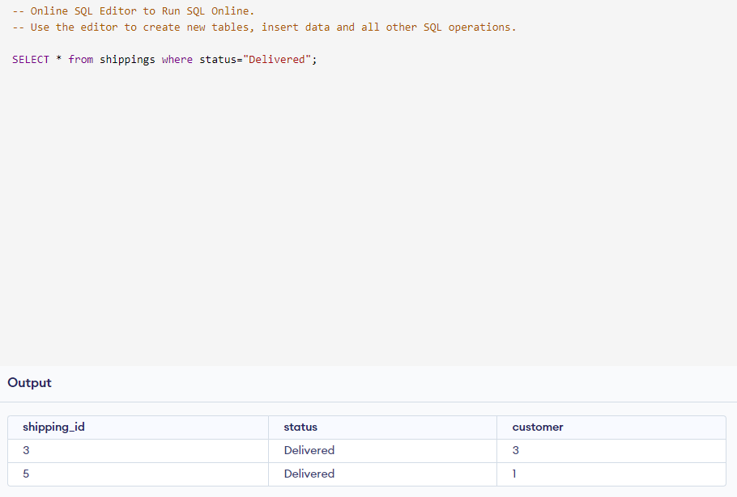
Menampilkan semua data pengiriman yang terkirim
Result

Slide 30
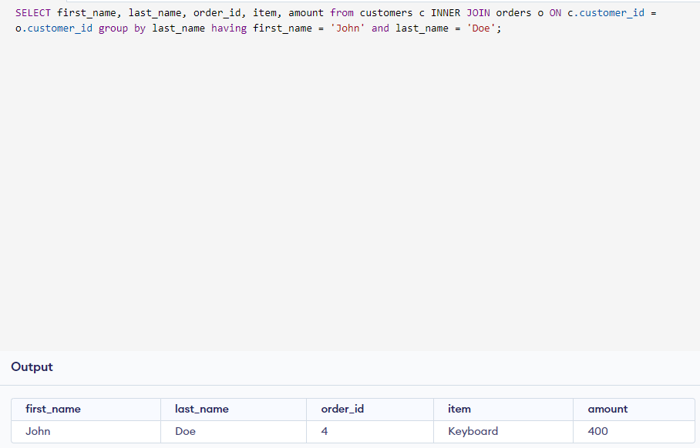
Menampilkan catatan dari table pemesanan yang dibuat oleh John Doe
Result

Slide 31
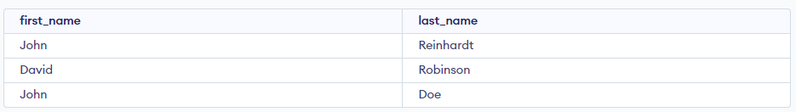
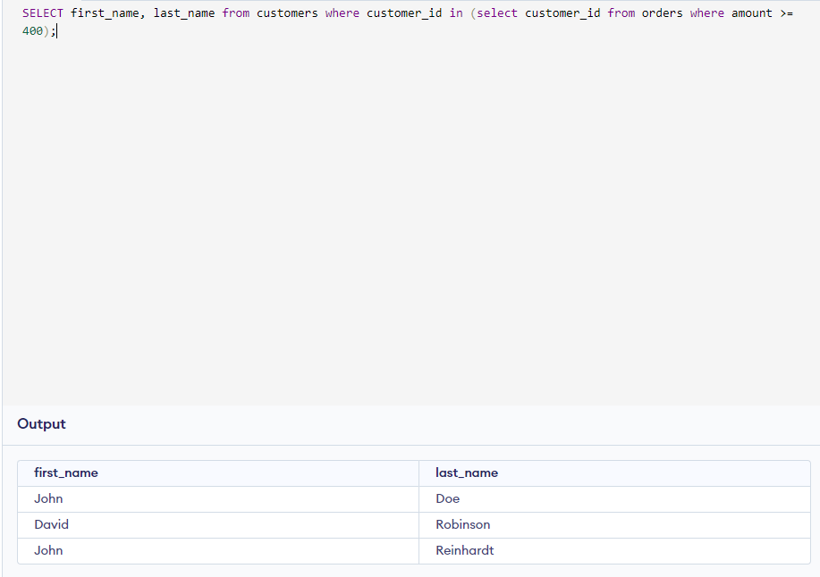
Menampilkan nama depan dan nama belakang Pelanggan yang melakukan pemesanan lebih dari atau sama dengan 400
Result

Slide 32
TERIMA kasih
- Husein -

